Slide 1
Revolutionizing Actuarial Reserving Workflows with chainladder-python
John Bogaardt, WCF Insurance, Chief Actuary
Henry Liu, Amazon, Principal Actuary
Thursday, December 12th (3PM)

Slide 2
As participants in this conference, it is essential to adhere to antitrust laws to ensure a fair and competitive environment. The following guidelines are designed to help us comply with these laws:
Policy Adherence: It is the policy of this conference to comply fully with both the letter and spirit of federal and state antitrust laws.
Avoid Discussions on Pricing: Do not discuss prices for services or products, or any other topics that might affect prices.
No Market Allocation: Refrain from discussing plans regarding specific geographic or product markets, or particular customers.
Membership Restrictions: Avoid conversations about membership restrictions or conditions on trade.
Product Standardization: Do not engage in discussions about product standardization that could be perceived as a restraint on trade.
Leave if Necessary: If any discussion appears to violate these guidelines, please leave the meeting immediately and report the incident to the conference organizers.

Slide 3




Thank you to conference sponsor
Please remember that the views and opinions expressed in the sessions are those of the speakers and do not necessarily reflect the views or positions of their employers, Full Stack Actuarial, the conference sponsors, or any other entity that they may be associated with.

Slide 4
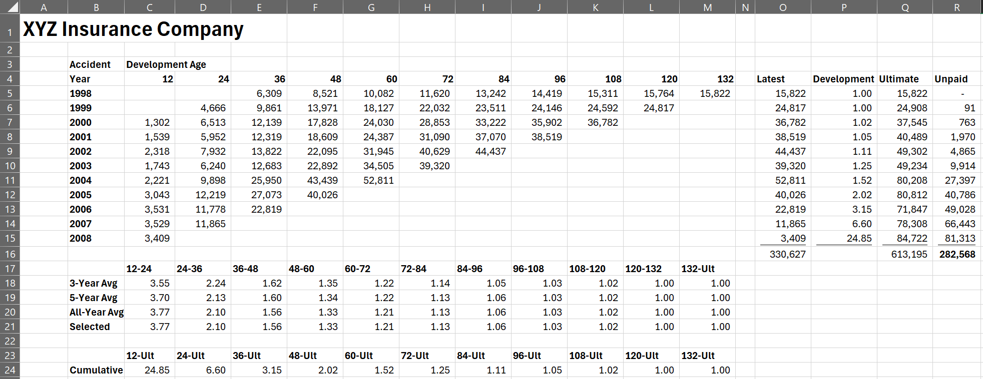
What is a lag study?
Basic Example in Excel
Triangle
Model
Development

Slide 5
Drawbacks
Requires managing Row/Column real estate
Requires VBA for non-Excel integrations
Does not scale well to hundreds of Triangles with a variety of different assumptions.
Hand-crafting algorithm logic
Benefits
Print-ready exhibits
Highly portable – everyone has MS Excel
A Basic Lag Study
Excel – Benefits and Drawbacks

Slide 6
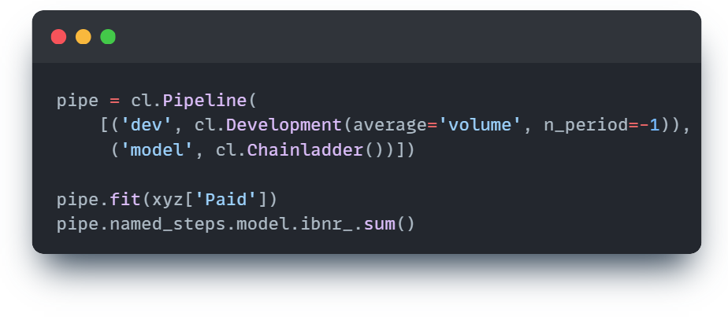
A Basic Lag Study
chainladder-python
Benefits
No need to manage data shape
Transparency on model structure and assumptions
Independence of Model and Data
Fitted attributes available on demand.
Opens door to other integrations supported in Python –
Testing frameworks
Database I/O
Task Schedulers
Drawbacks
Not print-ready exhibits
Not Highly portable

Slide 7
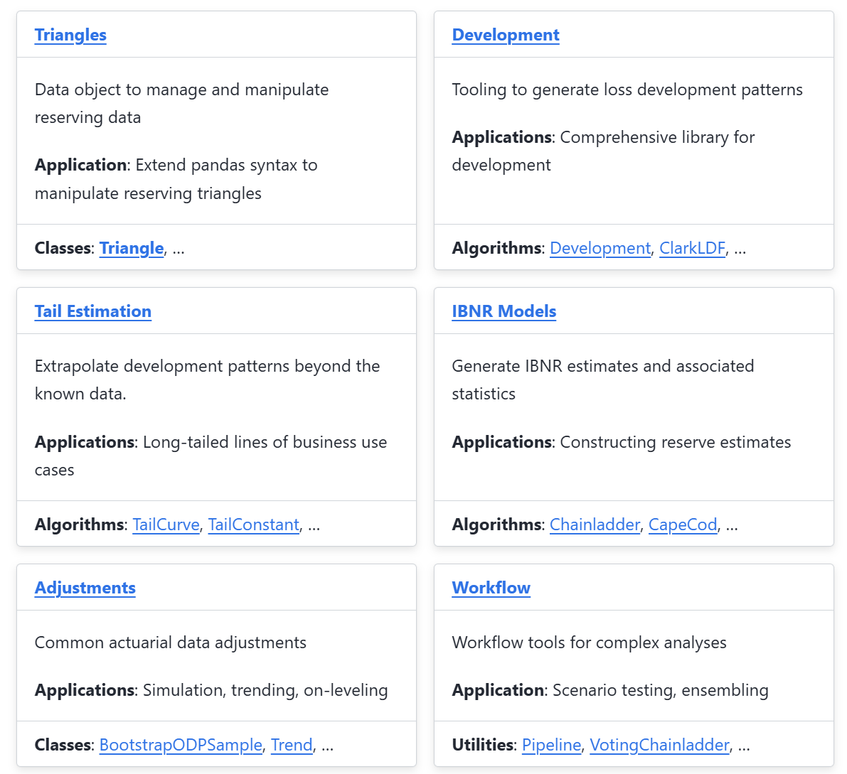
Chainladder-python - A Convenient Package for conducting lag studies
Inspired by the syntax of pandas and scikit-learn. chainladder-python is a suite of tools to:
Managing sets of triangles
Extrapolation beyond the observed triangle
Implementation of the most widely used lag study algorithms
Common data preprocessing steps
Tools to make composite estimators
Installation
OR
pip install chainladder
conda install chainladder

Slide 8
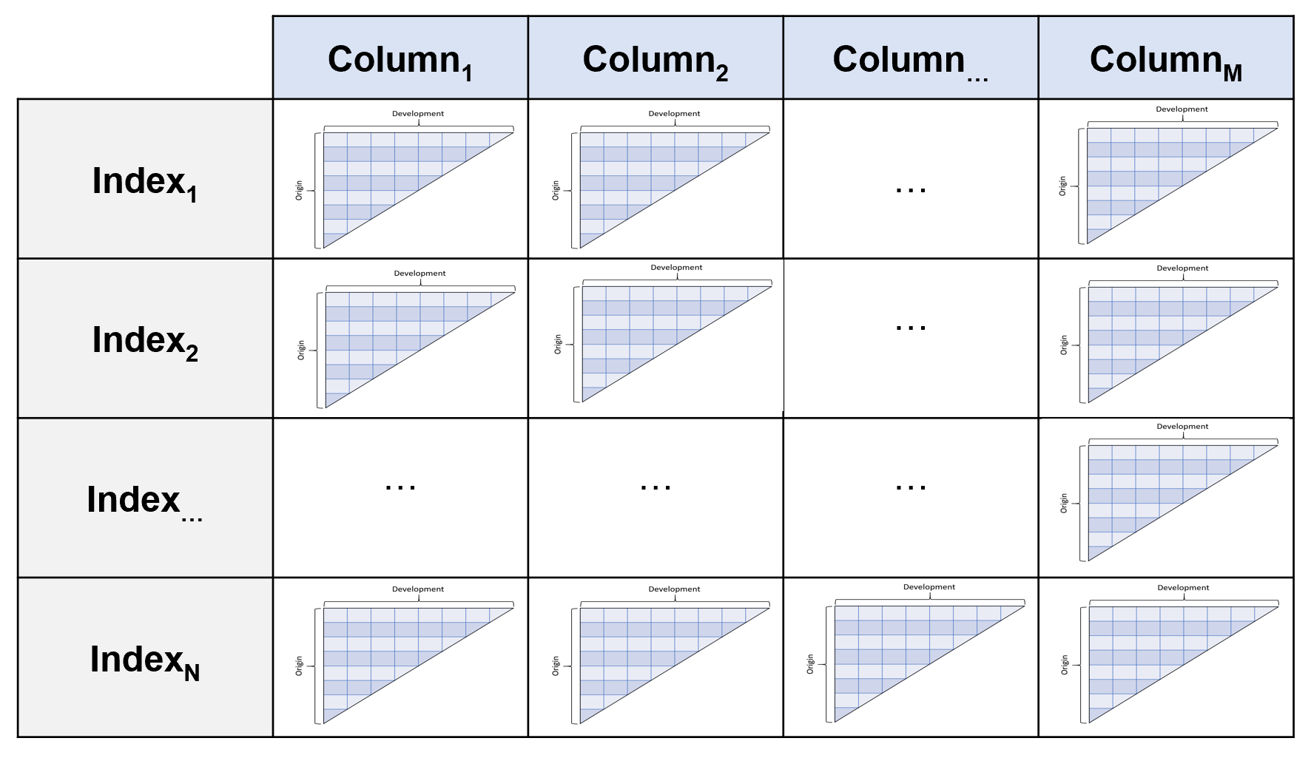
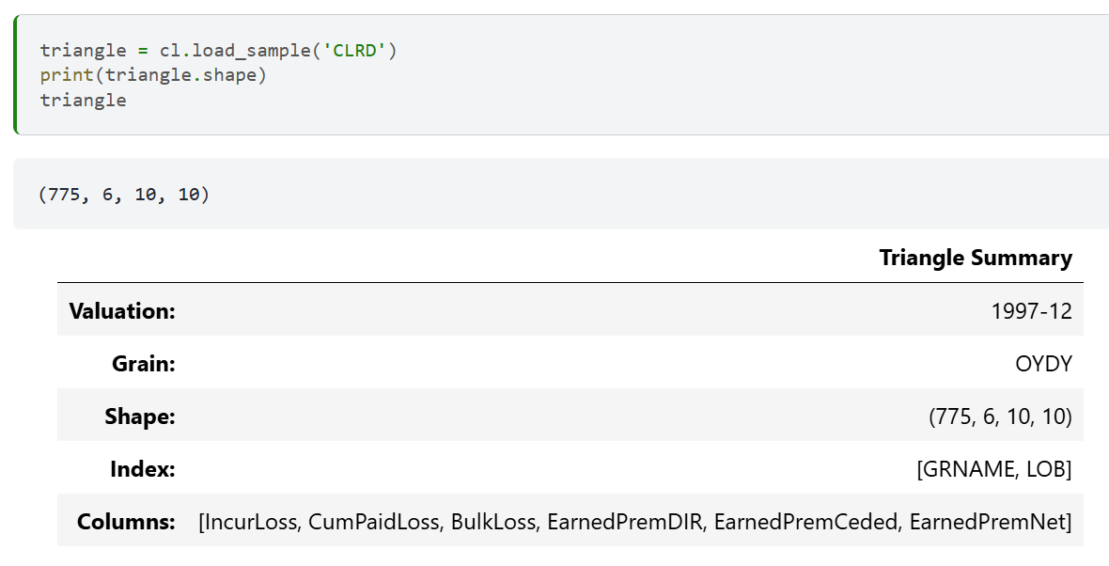
Data Management Triangles as a data type
Chainladder-python includes a Triangle object which behaves like a pandas DataFrame with individual triangles as their own data type.

Slide 9
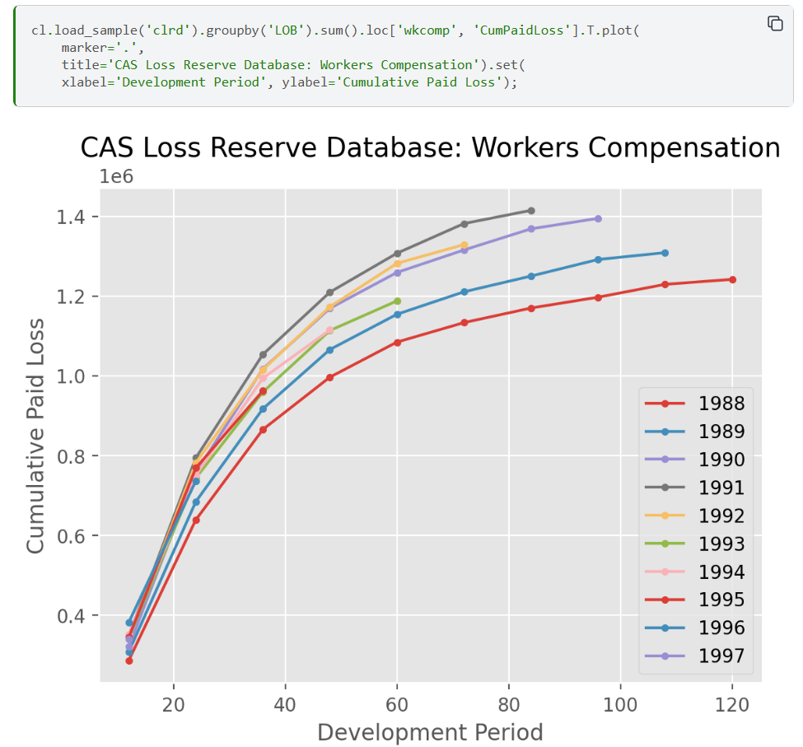
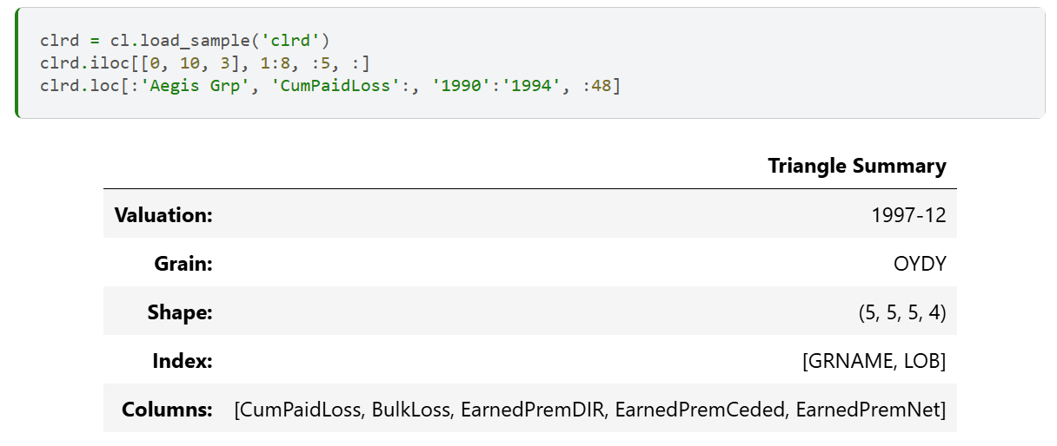
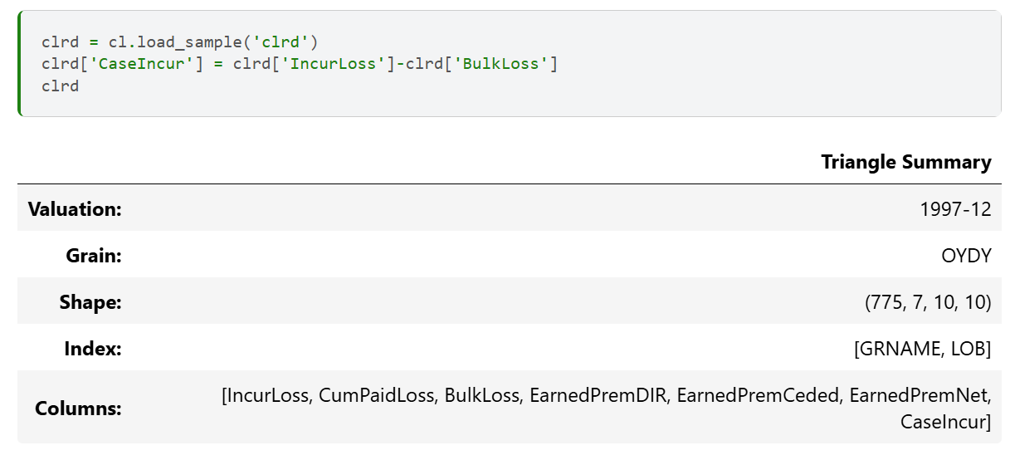
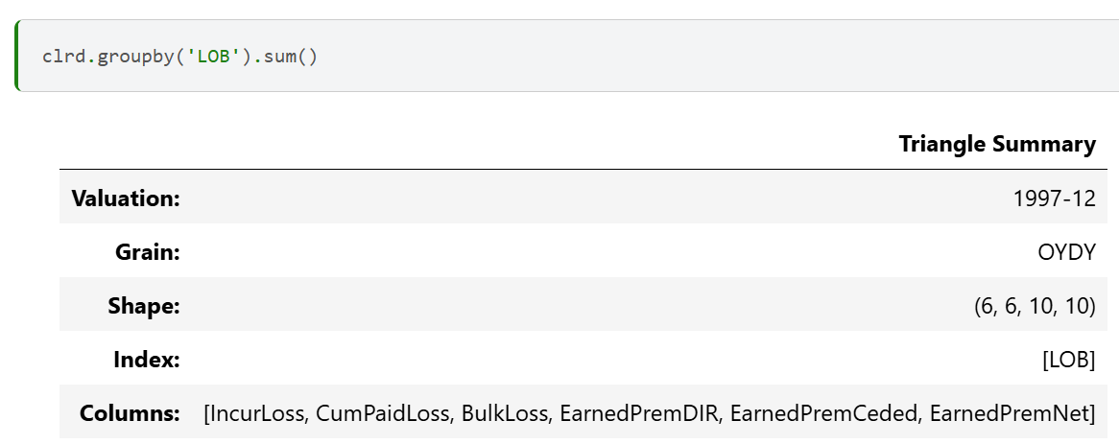
Pandas functionality A multi-dimensional triangle retains a lot of the core functionality of a pandas DataFrame emulating the same syntax
Column arithmetic
Slicing and filtering
Plotting
Grouping and Aggregating

Slide 10
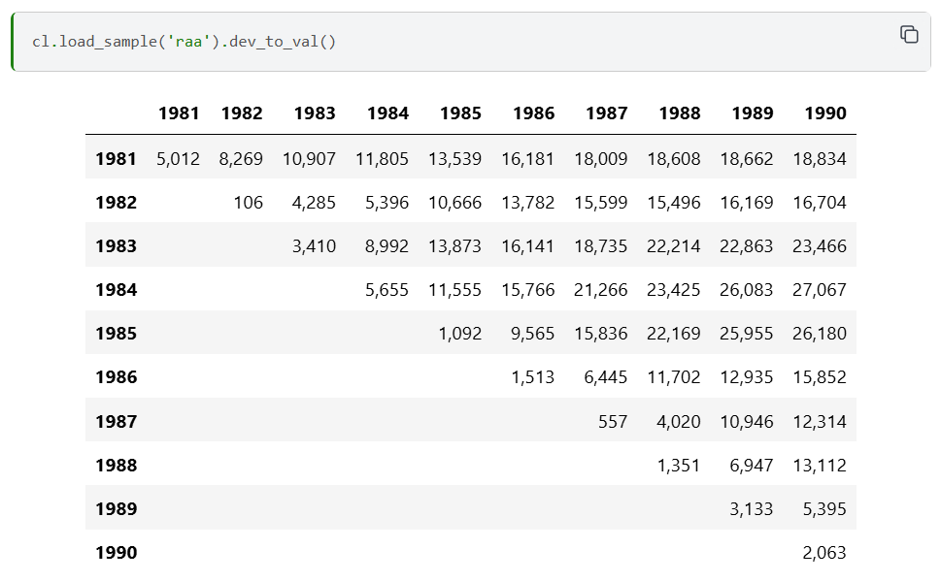
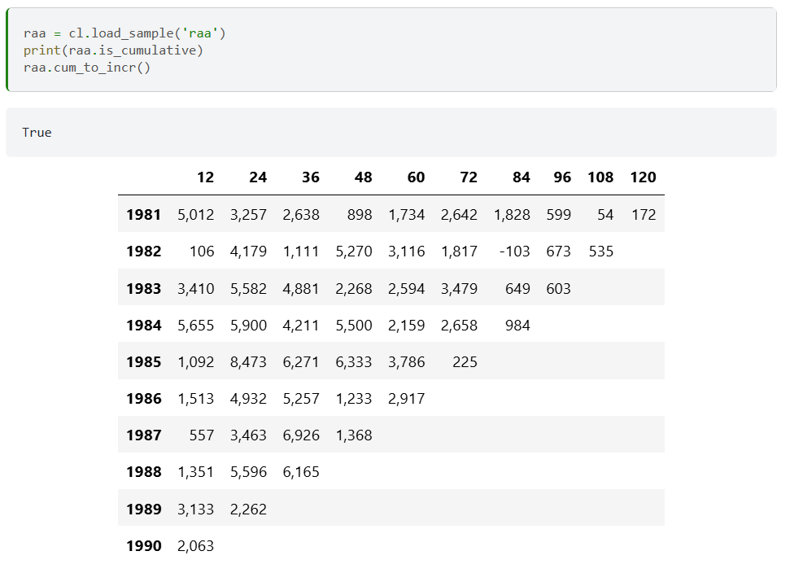
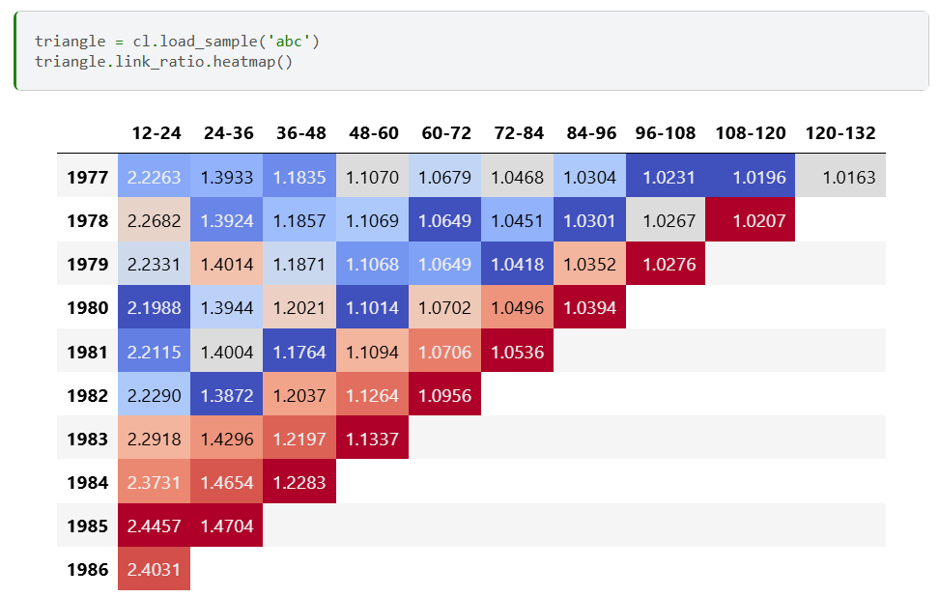
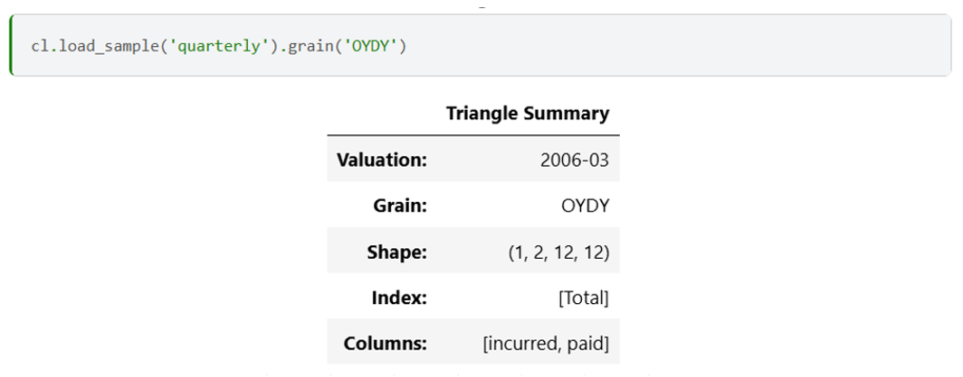
Domain specific The multi-dimensional triangle includes convenience methods beyond those of pandas geared toward lag studies.
Cumulative vs Incremental Views
Development or Valuation Views
Link Ratios
Grain changes

Slide 11
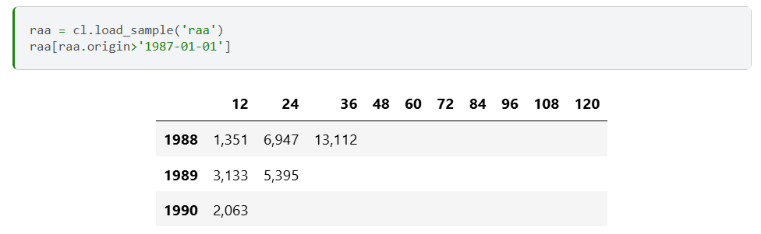
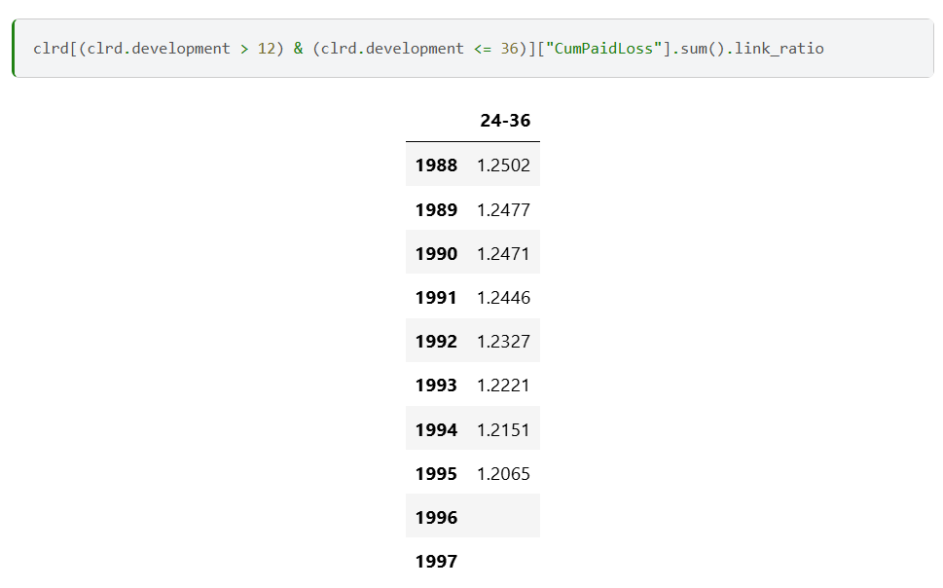
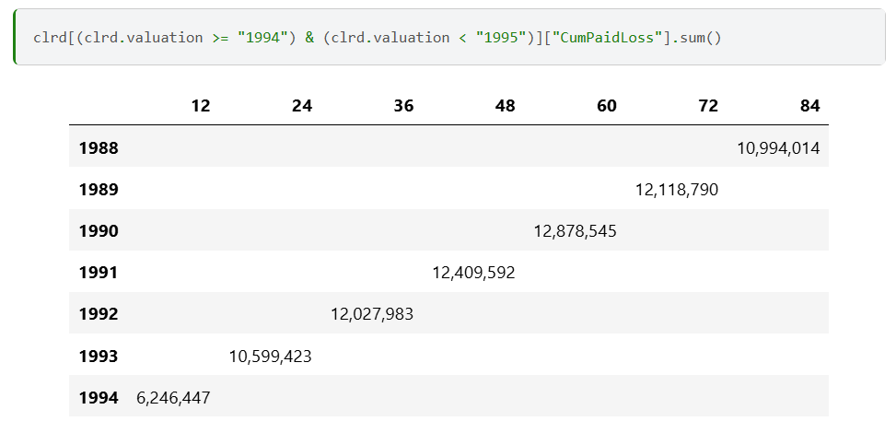
Extended Accessors The multi-dimensional triangle emulates pandas dt and str accessors to manipulate the time dimensions of a triangle.
Origin (Rows)
Development (Columns)
Valuation (Diagonals)

Slide 12
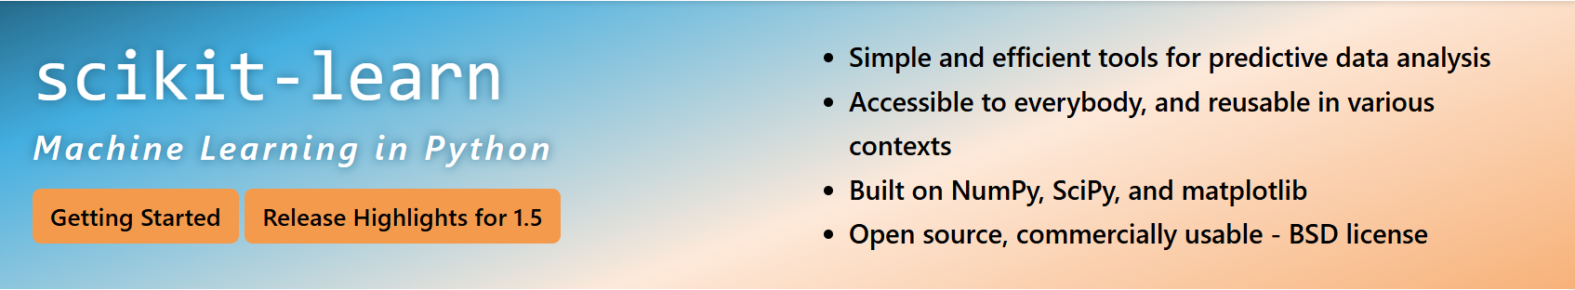
Model Construction Adopting the Scikit-Learn API
Object-Oriented interface centered around the concept of an Estimator:
An Estimator is any object that learns from data; it may be a classification, regression or clustering algorithm or a transformer that extracts/filters useful features from raw data.
- Scikit-learn Tutorial

Slide 13
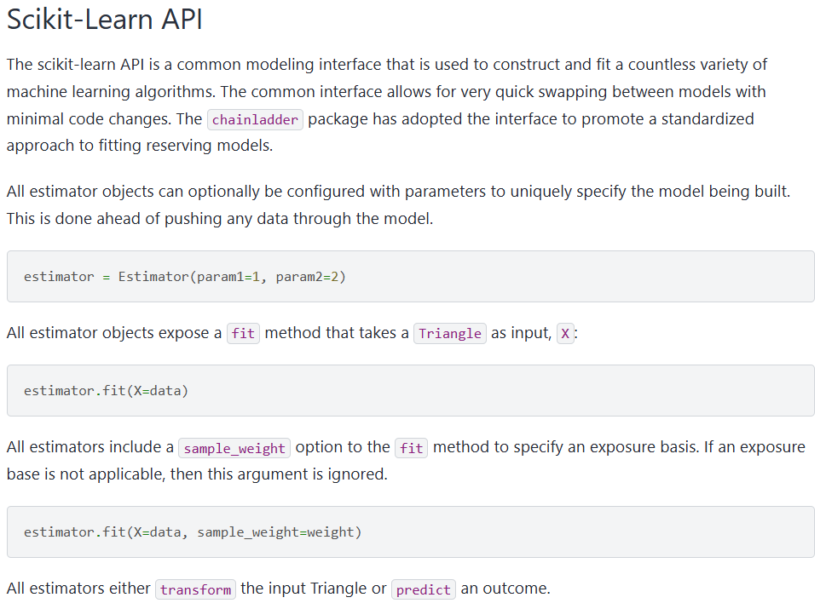
Model API

Slide 14
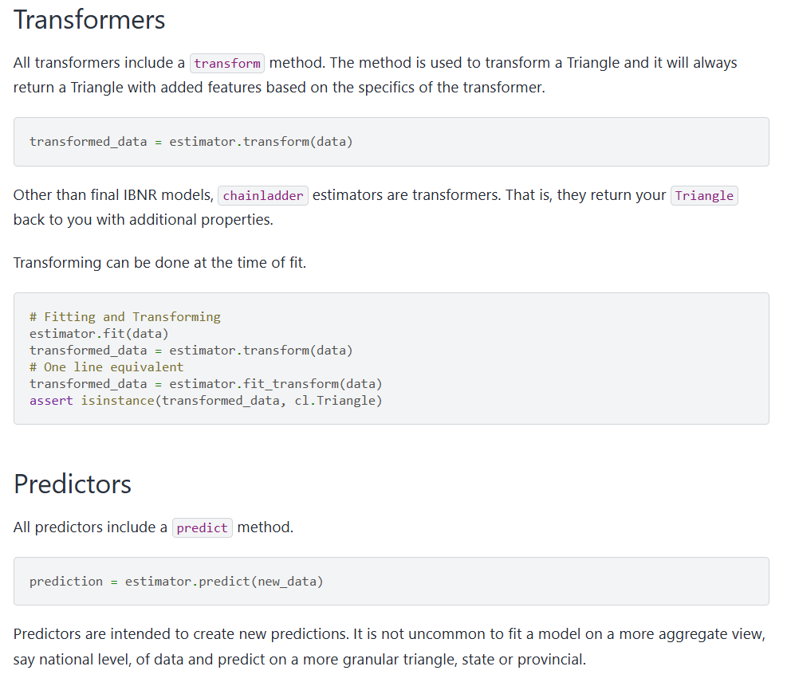
Model API

Slide 15
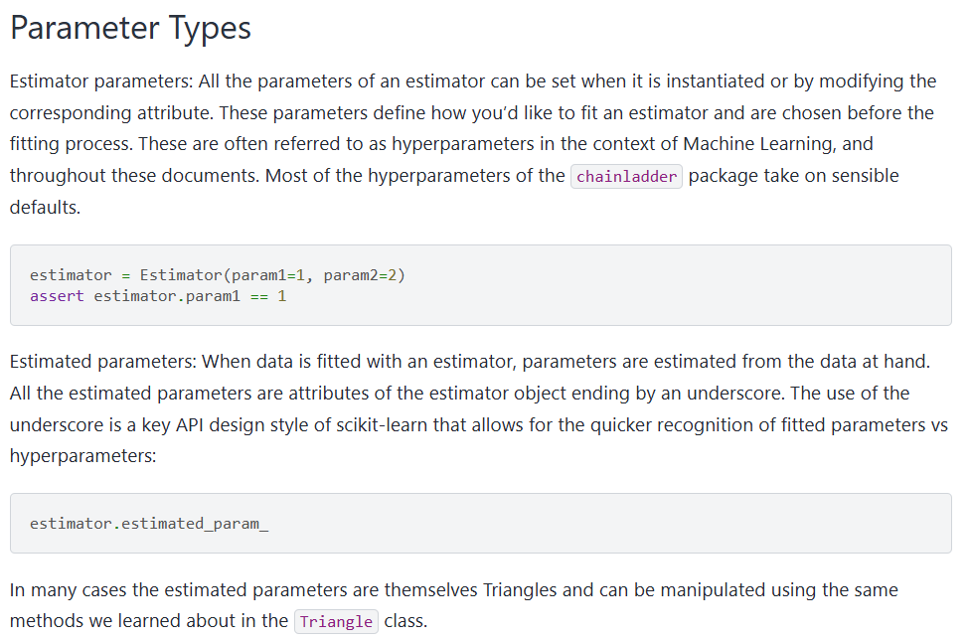
Model API

Slide 16
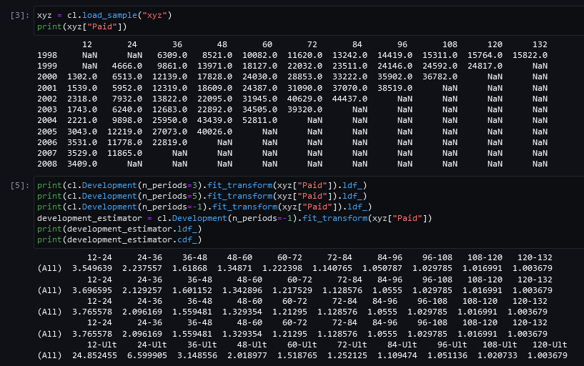
Development Factor Estimator
Triangle
Model
Parameter
Development
Fitted model

Slide 17
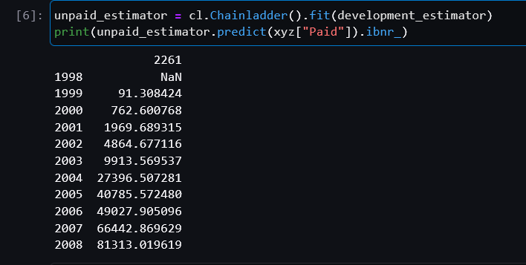
Unpaid Estimator
Triangle
Model
Model
Prediction
Development

Slide 18
Practical Examples
Sensitivity Testing
Managing lag study over time

Slide 19
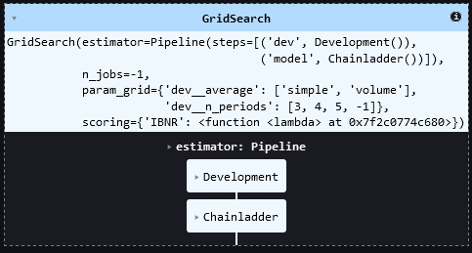
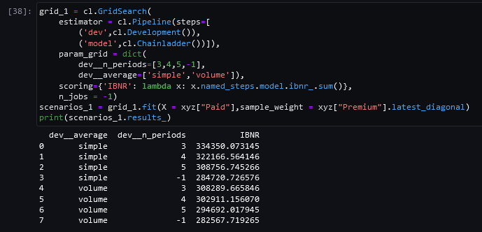
Sensitivity Testing #1
Chainladder has built-in functionality to iterate through many sets of assumptions. This example demonstrates how to calculate total IBNR for different LDF selection periods (“n_periods”, -1 means all) and averaging weights (“average”). The (-1, volume) scenario coincides with the previous example

Slide 20
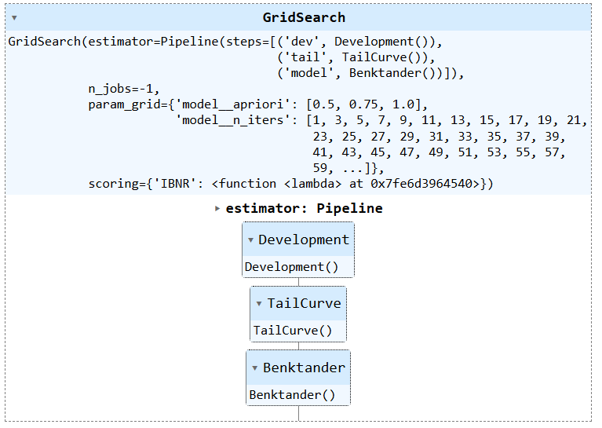
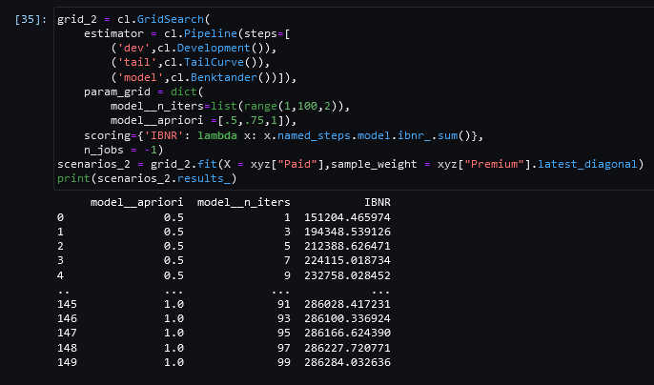
Sensitivity Testing #2
This example demonstrates the relationship between the Chainladder and BornhuetterFerguson methods by way of the Benktander model. Each is a special case of the Benktander model where n_iters = 1 for BornhuetterFerguson and as n_iters approaches infinity yields the chainladder. As n_iters increases the apriori selection becomes less relevant regardless of initial choice.

Slide 21
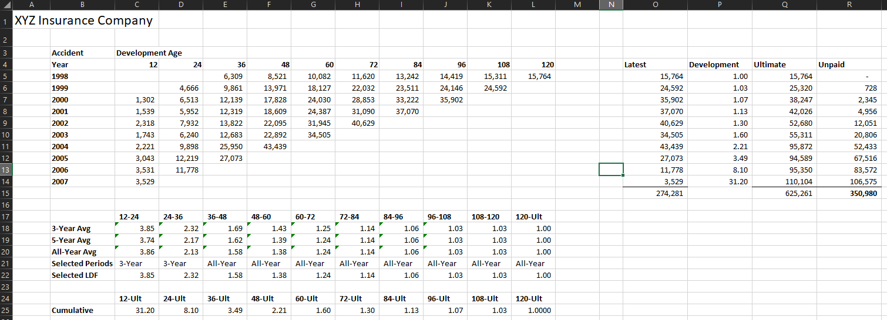
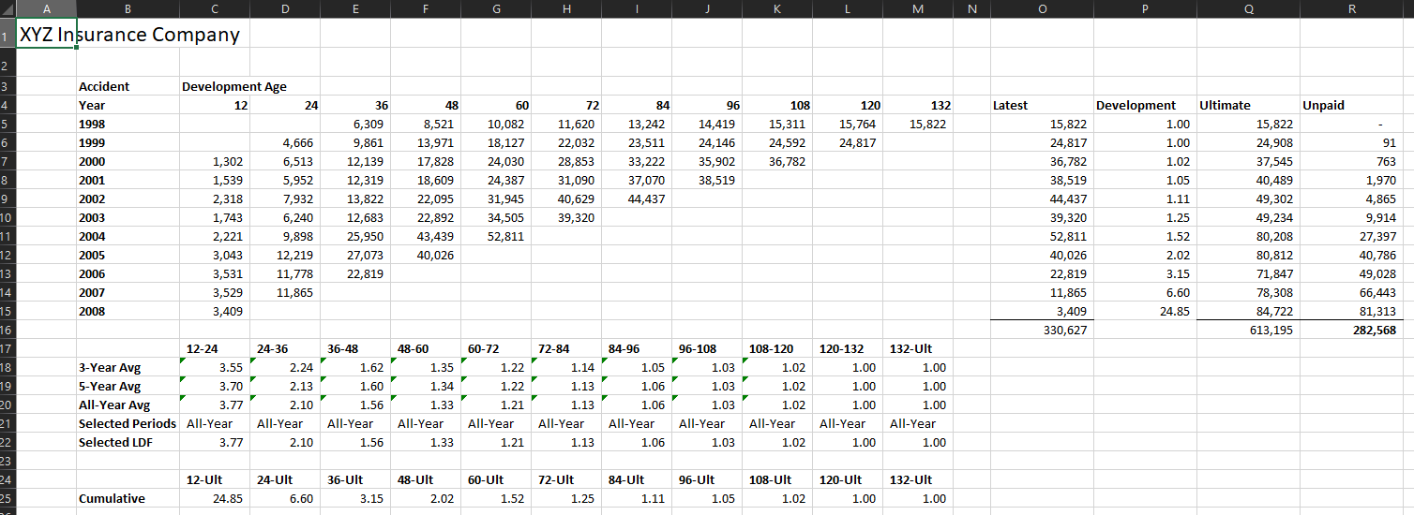
Waterfall Chart/Analysis Comparison
From month to month or year to year, ultimates change from one analysis to the next. A common question that comes up is “what drove the change?” Answering this question is both helpful for actuaries peer reviewing the analysis and explaining the change to other stakeholders.
In an Excel environment, analysis comparison is often done by hand, requiring the actuary to manually copy the analysis file several times. For multiple methods per segment and multiple segment overall, this quickly gets out of hand. This is time-consuming and prone to manual errors.
Prior Analysis
(2007)
Current Analysis
(Current)

Slide 22
Waterfall Chart/Analysis Comparison
2007 Analysis
2008 Analysis
2007 Data
2007 Sel
This comparison is can be performed in Chainladder more efficiently. To start, let’s visualize the standard pipeline for estimating an ultimate. From this point, we can increment each component from 2007 to 2008
2008 Data
2008 Sel
Dev Estimator
Dev Estimator
2007 LDF
2008 LDF
IBNR Estimator
IBNR Estimator
2007 Ult
2008 Ult

Slide 23
Waterfall Chart/Analysis Comparison
2008 Analysis
w/ 2007 LDF
2008 Analysis
w/ 2007 Sel
2007 Analysis
2008 Analysis
2007 Data
2007 Sel
2008 Data
2008 Data
2007 Sel
2008 Data
2008 Sel
Dev Estimator
Dev Estimator
Dev Estimator
2007 LDF
2007 LDF
LDF
2008 LDF
IBNR Estimator
IBNR Estimator
IBNR Estimator
IBNR Estimator
2007 Ult
Waterfall Step #1
Waterfall Step #2
2008 Ult

Slide 24
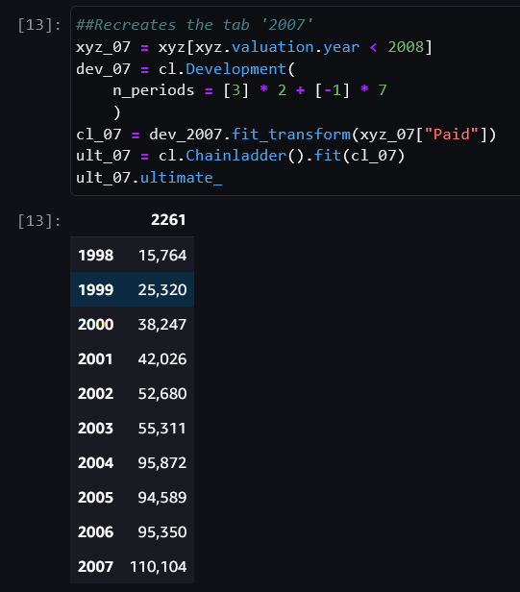
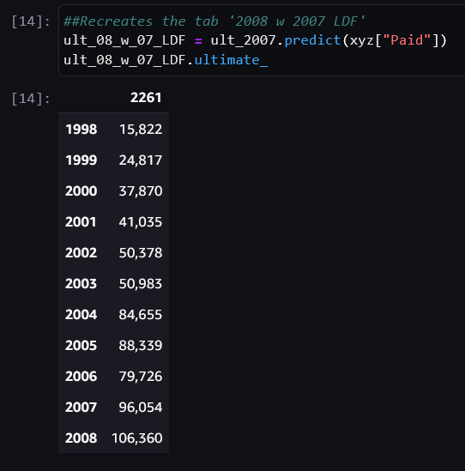
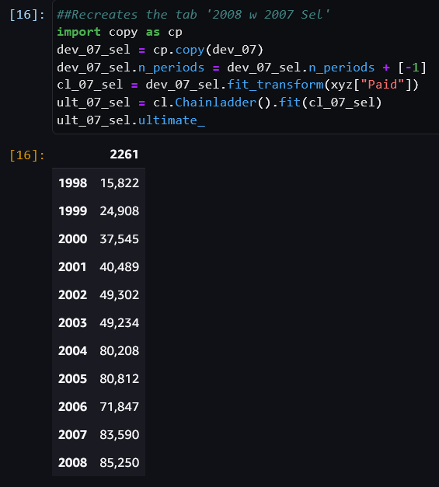
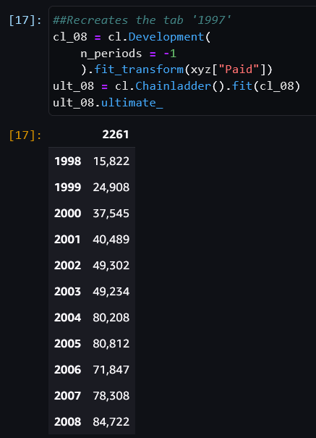
Waterfall Chart/Analysis Comparison
2008 Analysis
w/ 2007 LDF
2008 Analysis
w/ 2007 Sel
2007 Analysis
2008 Analysis
The same work process can be handled via a few of lines of code, leveraging the scikit-learn frame to be able to “Fit” (derived LDF) and “Predict” (calculate ultimate) independently.
To extend this process to more methods and segments, add loops or utilize the built-in index in Chainladder

Slide 25
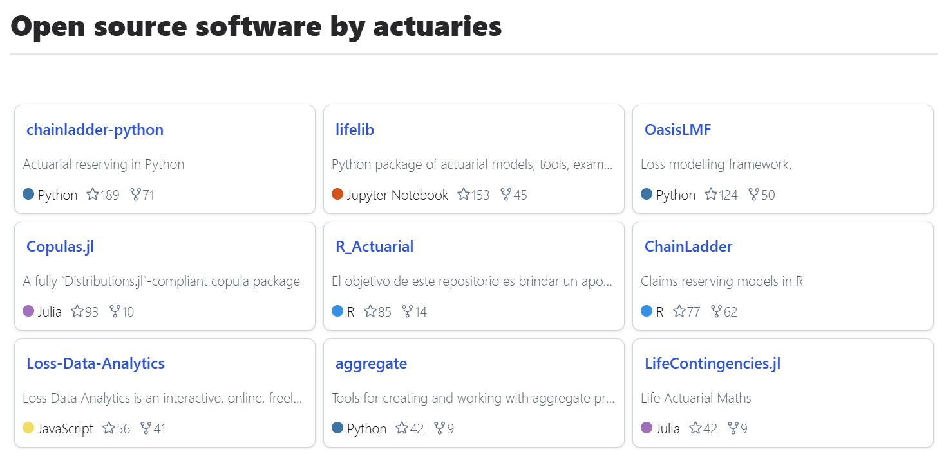
Source: www.actuarialopensource.com
Chainladder-python is currently the most popular actuarial-focused open source package as measured by github stars

Slide 26
Papers with citation of the package:
The Actuary and IBNR Techniques: A Machine Learning Approach
Ultimate Loss Reserve Forecasting Using Bidirectional LSTMs
Practitioners’ Guide to Building Actuarial Reserving Workflows Using Chain-Ladder Python

